Slide 1
The committee welcomes you to the SPS
Cédric Bossart Director, Clinique de Genolier
Pierrette Chenevard CEO, Espace Compétences SA
Stéphane Coendoz Director, Zambotte - Savièse
Christian Fracheboud Expert consultant in the health sector
Hanny Hendriks Training Manager, Espace Compétences SA
Rodolphe Rouillon Director, Hôpital Intercantonal de la Broye - HIB
Géraldine Spinelli SPS Coordinator, Espace Compétences SA
27 April 2023 Lausanne, IOC Museum
Notes:
Red badge

Slide 2
THANK YOU to our speakers, for their participation, their knowledge, their expertise, their availability and their commitment
We are certain that they will allow enriching exchanges
The conferences are translated into French or English
  The presentations will be available next week on
  on the website www.pratique-sante.ch or www.espace-competences.ch/event

Slide 3
A special thank you, also, to Dr Vermeulen,
President of the Board of Directors of Espace Compétences SA
For his availability, his dedication to the training business and
for agreeing to co-host the round table
His medical expertise and leadership skills, together with those of Cédric Bossart, will provide perspectives for a rich debate

Slide 4



Thank you to our sponsors for their support!
They help to make this seminar possible.
Their commitment and support make this annual event at the of this annual event at the Olympic Museum.
Notes:
2-3 minute film when you return from your breaks for Cades and Hirslanden

Slide 5

The SPS supports the PATOUCH Association, to whom we express our gratitude for their commitment to our young people.
Patouch is an association for the prevention of violence involving children and adolescents.
It is a non-profit NGO, recognised as being of public utility.
www.patouch.ch
Notes:
2-3 minute film when you return from your breaks for Cades and Hirslanden

Slide 6
Some details on the organisation
At the restaurant upstairs:
break at ~10:15 -10:45
lunch at ~ 12.30 - 14.10
aperitif! ~15h45
Géraldine Spinelli is at your disposal for any organisational questions

Slide 7
In your envelope you will find
The list of participants
Your certificate of attendance
The day's programme
Information on the PATOUCH association
Seminar flyer

Slide 8
Book now for Thursday 25 April 2024
here for our next seminar!

Slide 9
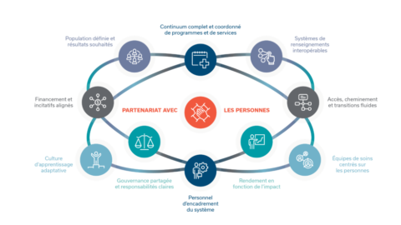
"Integrated care: from a population-based approach

Slide 10
Concept of our 2023 seminar
Academic framework
Experiences & Practices & Innovations
Voice of the customers through your interventions
  To ask your questions, a QR CODE will be available on the tables in the restaurant, available from 12:15 to 13:00
  Your comments will also be welcome live
  at the round table

Slide 11
In 2017, our seminar was entitled
From silos to networks for an all-inclusive service

Slide 12

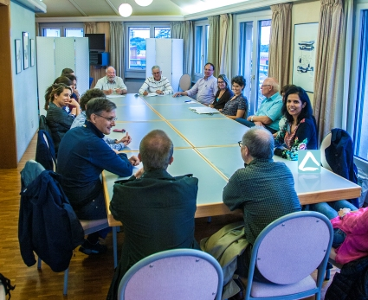
2017
Towards an integrated care system around the patient → www.vaud.ch
To encourage people to stay at home for as long as possible, emphasis will also be placed on the integrated operation of the first line of care and on disease prevention. The aim will be to build a system around the patient, with the full involvement of the patient, which will enable the patient's needs to be rapidly assessed and the patient to be directed to the most appropriate resource.
In Switzerland,
we have been talking about networks
for more than 15 years
1992
Auteur(s) / Author(s)
ROSSI Ilario ⁽¹⁾ ;
Experiencing Medical Power and the State : Healthcare networks, health networks: Promethean culture or the liberty of impotence?
⁽¹⁾ University Department of Medicine and Community Health at the Faculty of Social and Political Sciences of the University of Lausanne, SWITZERLAND
Abstract: Economic globalisation and the technological revolution induce, in Western countries, important reforms of health systems and call into being new models of health management. Increasingly, the convergence of medical, economic and technical rationalities results in the evaluation of health care in terms only of efficiency. The concern for therapeutic effectiveness becomes inseparable from the question of financial cost. In the face of broad changes in the epidemiological panorama, health care providers worldwide question their traditional roles and interrogate the growing gap between research and practice. In this context, public health organizations in Switzerland rework their relations to care management contractual partners. They react to changes toward rationalization and reorganization in their work by forming networks. Caught between constraint and innovation, these networks work ambivalently to modify knowledge and practice. While associating themselves with notions of technological progress, they also call for an examination of the political goals, ethical issues and cultural values at the heart of the systems they work within. Revue / Journal Title Tsantsa ISSN 1420-7834 Source / Source 2002, nº 7, pp. 12-20 [9 page(s) (article)] (20 ref.)
2002
Networks accountable to their populations Modernising health management and governance
Denis A. Roy, MD, MSc, MPH, FRCPC,
Eric Litvak, MD, MSc, MM, FRCPC,
Fred Paccaud, MD, MSc, is Director of the University Institute of Social and Preventive Medicine in Lausanne and of the Swiss School of Public Health in Zurich. He teaches epidemiology and public health at the Faculty of Medicine in Lausanne.
2010

Slide 13
6 years later! The network is back! with a complementary, or even different, approach to our Swiss health care system

Slide 14
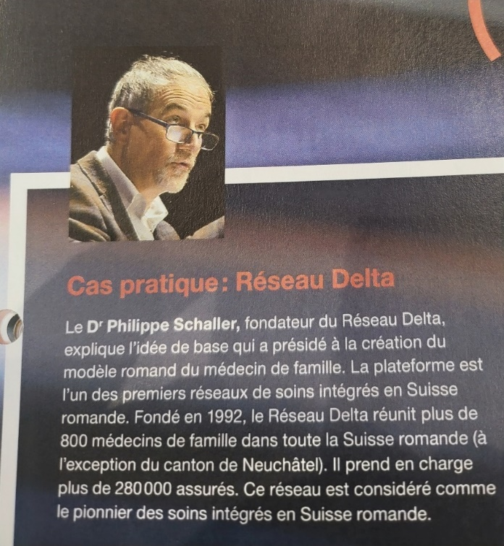
Pioneer in Switzerland: Dr Philippe Schaller accompanied by the students of the CAS in complex pathway UNIGE/EC
It started in 1992 with the DELTA Network.
And is now continuing with pilot projects
EHC - Arsanté/Delta
Project submitted to the FOPH in January 2023
Modelling with the cantons of Vaud and Geneva
Contractualisation with health insurers

Slide 15
Why rethink our health system?
The needs of the population are changing, with new expectations
expectations of health care
Health costs continue to rise, with funding challenges
challenges to be met
Technological advances offer new opportunities to improve healthcare
to improve health care
We need a new vision for a more efficient and sustainable health care system in Switzerland and sustainable health system in Switzerland

Slide 16
Are we bold enough in Switzerland to give power to the Microsystem?
Microsystem
Mesosystem
Macrosystem
Because an integrated system of care means empowering the professionals who work
with the beneficiaries
It means working in partnership with the patient
This is the undeniable challenge:
To hear and accompany the patient
in their individuality!

Slide 17
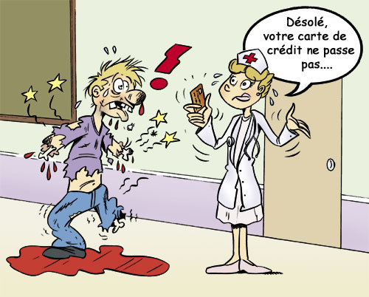
The fear is obviously to have
→ An exclusive health system, with
2-speed medicine
→ Limited access to health care depending on socio-economic status
→ Projects that create disparities in the quality and availability of health care

Slide 18

Today, in this audience we have
health professionals, researchers, innovators, entrepreneurs, patients and citizens who are demanding change...

Slide 19

So let's hear it from them!

